Slide 1
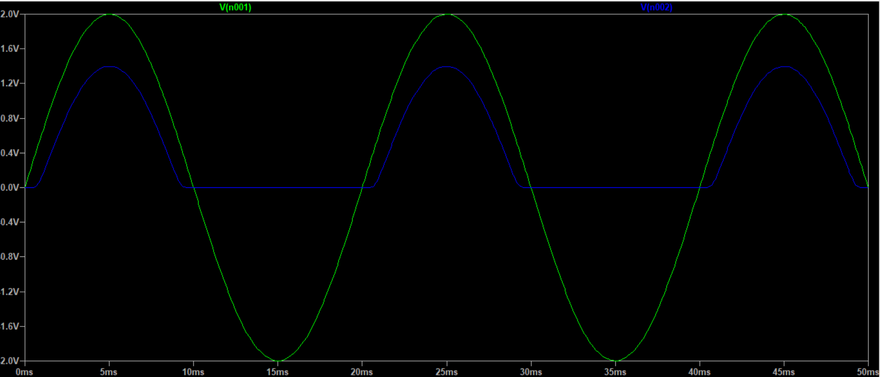
Exercise 7

Slide 2
Exercise 7
From the graph above:
Width of Pulse: 9.756 – 0.384 = 9.372ms
Peak Voltage: 1.398V
The peak voltage and width are both a bit less than what I expected – I didn’t expect such a voltage decrease since the resistance of the diode is quite low compared with the 1kΩ resistor – but they are within reasonable range.

